Slide 1

Case Study: Analysis Of Superstore Dataset
By
SWAPAN KUMAR SHEE
Student ID:STU62144fbfd77da1645498303
Internship ID: INTERNSHIP_168198413964410a8b547b1

Slide 2
Outlines
Student Details
Project Title/Problem Statement
Agenda
Project Overview
Who Are The End Users Of This Project?
Your Solution And Its Value Proposition
How Did You Customize The Project And Make It Your Own
Modelling
Results
Links
Acknowledgement

Slide 3

Student Details
Name: Swapan Kumar Shee
Skills Build Email ID:sapans2003@gmail.com
College Name:University of Engineering & Management Jaipur (UEM Jaipur)
College State: Rajasthan
Internship Domain: Data Analytics(DA)
Internship Start date :12-06-2023
Internship End Date:24-07-2023

Slide 4
Project Title/Problem
Statement
The Superstore dataset contains a wealth of information about customer behavior, product sales, and financial performance. By analyzing this data, the Superstore can gain insights into how to improve its sales and profits.
The specific objectives of this project are to:
Identify the most popular products sold by the Superstore.
Determine which regions generate the most sales for the Superstore.
Identify which factors is majorly affecting the profit and loss.

Slide 5
Agenda
1.Define the problems
2.Importing Libraries
3.Importing the dataset
4.Cleaning of data-Pre-Processing of data
5.summarizing data set to extract insights
6.Visualization Of Data
7.Conclusion

Slide 6
Project Overview
Purpose:
The purpose of this project is to perform data analysis on the Superstore dataset in order to gain insights into customer behavior, product performance, and sales trends.
Scope:
The scope of this project includes analyzing data from various perspectives such as product category, customer demographics, geographical location, and time period. We will also be identifying patterns and trends in sales data, and examining the relationship between different variables.
Objectives:
The objectives of this project are to:
- Identify best-selling products and categories
- Analyze customer preferences and behavior
- Identify key drivers of sales and revenue
- Identify areas for improvement in terms of customer experience and satisfaction
- Provide insights and recommendations to maximize sales and profitability.

Slide 7
Who Are The End Users Of This Project?
Overview: In this presentation, we will identify and describe the target audience or end users of our project and explain their characteristics, needs, and how they will benefit from our solution.
Target Audience/End Users:
1. Business Owners: Business owners who own small to medium-sized retail stores and supermarkets can be considered as our end users. They need to analyze sales data, inventory, and customer behavior to make informed decisions to drive their business growth further.
2. Sales Analysts: Sales analysts use analytics tools to quantify sales patterns and forecast the future sales trend. Analyzing data can help them identify loopholes in sales performance, inventory management, seasonal demand, and causes for the rise and fall of profit margins.

Slide 8
Who Are The End Users Of This
Project?
Characteristics and Needs:
1.Business Owners: They need a comprehensive data analysis report that provides valuable insights into sales data, inventory, demand forecasting, and returns.
2. Sales Analysts: They require a detailed data analysis report that can help them identify sales patterns, segment customers based on their behavior, predict sales trends, and develop a course of action to increase sales.
Benefits:
1.Business Owners: Our solution can help them gain a comprehensive understanding of their business's sales, performance, and customer behavior, allowing them to make informed decisions to drive their business growth.
2. Sales Analysts: Our solution can assist them in identifying the problem areas that hurt sales and taking corrective measures, resulting in improved sales performance and increased profitability.

Slide 9
Who Are The End Users Of This
Project?
Conclusion:
Our solution to the data analysis of the superstore dataset will cater to the needs of Business Owners, Sales Analysts, and Marketing Professionals. Our data analysis report will be comprehensive, detailed, and will provide valuable insights into sales patterns, customer behavior, inventory management, and customer segmentation. Our solution will help them make informed decisions, boost sales performance, and enhance business growth.

Slide 10
Your Solution And Its Value
Proposition
The Superstore dataset contains a wealth of information about the sales and profits of a chain of superstores in the United States. By analyzing this data, we can identify trends and patterns that can help the company improve its performance.
Our solution is a data analysis dashboard that provides insights into the following areas:
Product sales and profitability: We can track the sales of individual products and product categories, as well as the profitability of each product. This information can help the company identify which products are most profitable and which products are not performing well.
Sales trends: We can track sales over time, by product, by customer, and by region. This information can help the company identify seasonal trends, as well as trends that are specific to certain products or customer segments.

Slide 11
Your Solution And Its Value
Proposition
Value Proposition:
1. Time-Saving: Our solution will reduce the time required to derive meaningful insights from the data. This will enable the users to focus on taking action based on the insights.
2. Improved Decision-making: The insights provided by our solution will help the users to make informed decisions on sales forecasting, inventory management, pricing.
3. Increased Profitability: By using our solution, the Superstore will be able to improve its business operations
4. Competitive Advantage: Our solution will help the Superstore to gain a competitive advantage by providing it with a data-driven approach to business decision-making.
Conclusion:
Our data analysis solution will transform the Superstore dataset into valuable insights, improving decision-making and competitive advantage. With our solution, the Superstore will be able to make data-driven decisions to optimize its business operations and increase profitability.

Slide 12
How Did You Customize The Project
And Make It Your Own
1. Customization:
a. I used advanced statistical tools to analyze the data and identify patterns that were not evident in the original dataset.
b. I incorporated data visualization techniques to present the insights in a clear and understandable format.
2. Unique features:
a. My analysis included different types of visualizations in different techniques for understanding each features in better way.
b. I also analyzed the impact of different constraints which are the cause of the loss.
3. Innovation: The combination of advanced analytics, data visualization made my solution innovative and creative. It provided unique insights and actionable recommendations to improve business performance.
4. Conclusion: My customized solution sets us apart from existing ones by providing a more comprehensive and accurate analysis of the superstore dataset. It is remarkable for its use of advanced analytics and data-driven decision-making.

Slide 13
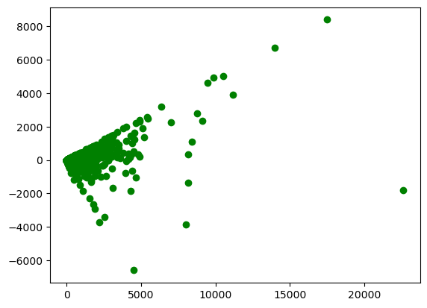
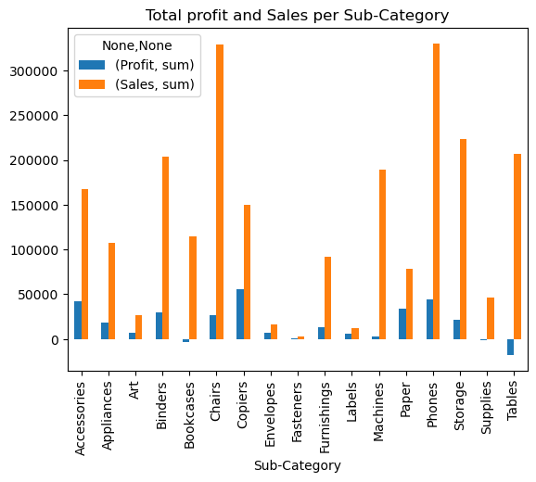
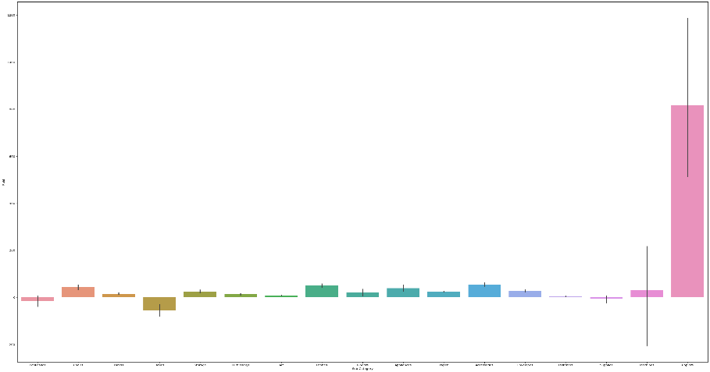
Modeling
Fig 1. scatter plot between sales and profit
Fig 2. Total profit and Sales per Sub-Category
Fig 3. Bar plot of Sub-category vs profit

Slide 14
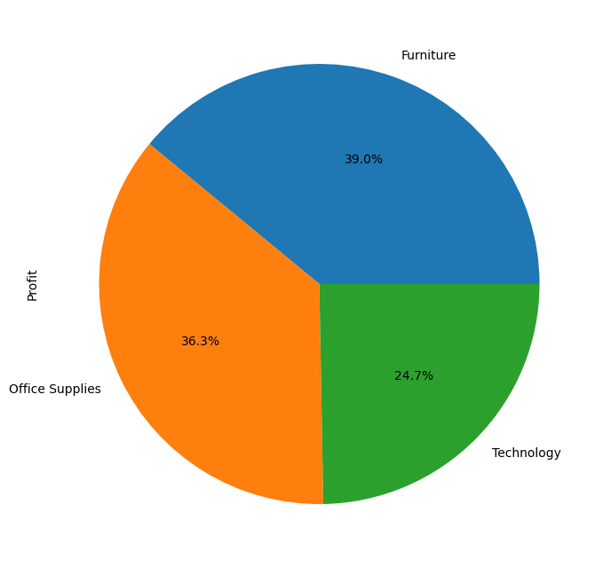
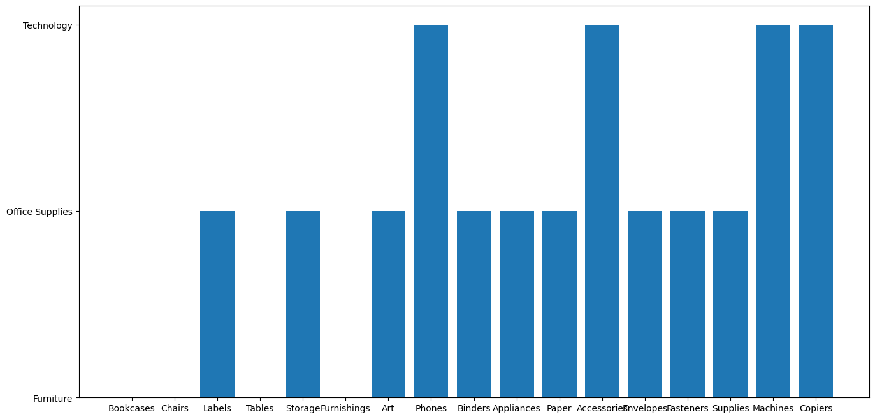
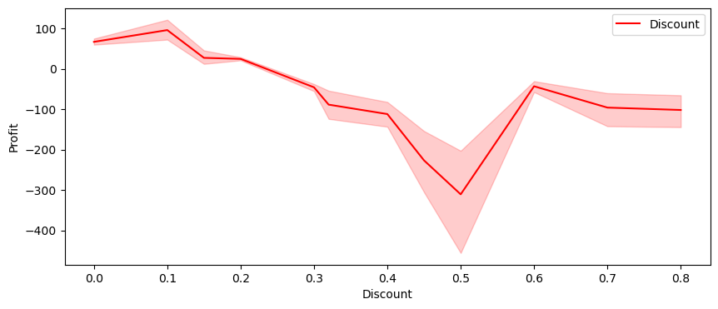
Modeling Cont.…
Fig 4. Pie plot of negative profit per category
Fig 5.Bar plot between Sub-category Vs category
Fig 6. Line Plot Of Discount Vs Profit

Slide 15
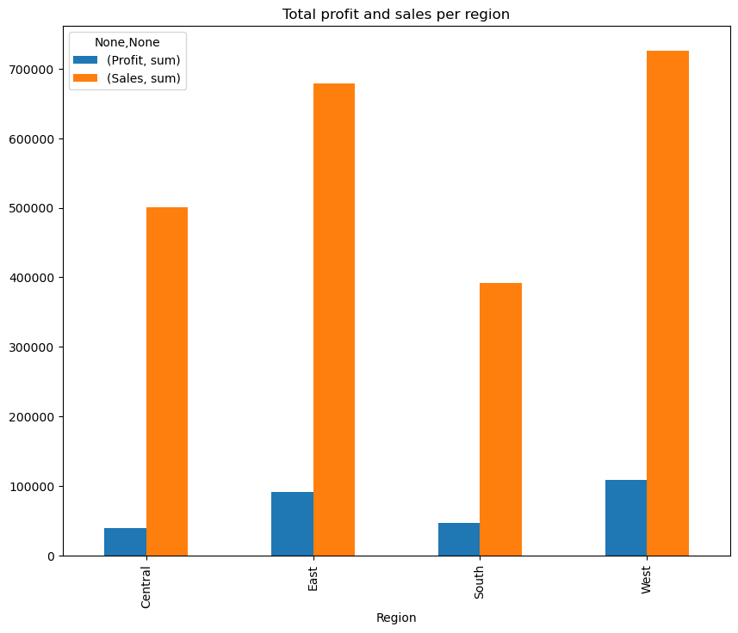
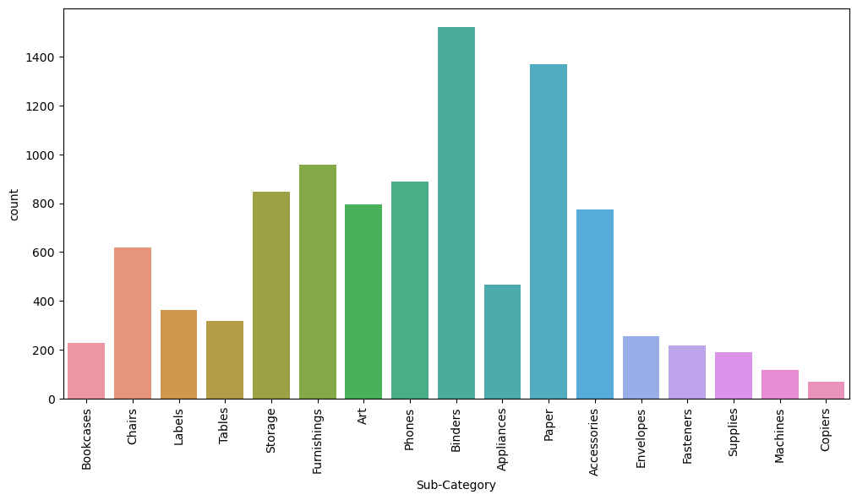
Modeling Cont.…
Fig 7.Bar plot of Sales and Profit Based on Region
Fig 8. Count Plot of Sub-categories

Slide 16
Results
1. Profit in south and central is less.
2. Profit In east and west region is better than south and central.
3. The Highest profit is earned in copiers while the selling of phones and chairs are extremely high compared to other products.
4. Another interesting fact-peoples don't prefer to buy tables and Bookcases from superstore as sales is medium but they are facing loss.
5. The store has wide variety of office supplies especially in Binders and Papers.
6. Negative correlation between profit and Discount.
7. Total sum of profit in sale of tables is negative.
8. Profit is more in sale of copiers.
9. No or very less profit in sales of supplies.
10.Technology segment is more profitable.

Slide 17
Links
GitHub Repository: https://github.com/swapan1389/IBM_Skillbuild_Data_Analytics_Intern.git
Kaggle Dataset: https://www.kaggle.com/datasets/bravehart101/sample-supermarket-dataset
Kaggle JupyterNotebook: https://www.kaggle.com/swapankumarshee/superstore-data-analysis
Jupyter Notebook: https://drive.google.com/file/d/1hHgB5dt2VvheeWeMikGSUM9BH2MirCI5/view?usp=sharing

Slide 18
Acknowledgement
The endless thanks goes to Lord Almighty for all the blessings he has showered onto me, which has enabled me to write this last note in my project work. During the period of my project, as in the rest of my life, I have been blessed by Almighty with some extraordinary people who have spun a web of support around me. Words can never be enough in expressing how grateful I am to those incredible people in my life who made this thesis possible. I would like an attempt to thank them for making my time during my project in the Institute a period I will treasure. I am deeply indebted to my research mentors for such an interesting thesis topic. Each meeting with him added in valuable aspects to the implementation and broadened my perspective. He has guided me with his invaluable suggestions, lightened up the way in my darkest times and encouraged me a lot in the academic life.

Slide 19


